Slide 1
PASSIVE SOLAR GREENHOUSE

Slide 2
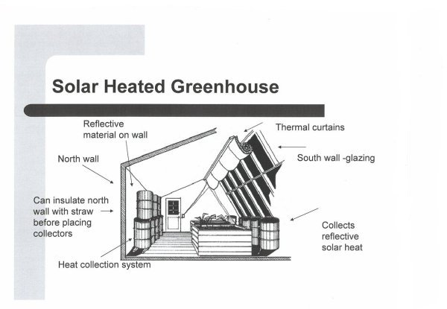
PURPOSE
Create a greenhouse that is 100% sustainable
Greenhouse to be used all year around
Picture source: http://bradford.cafnr.org/passive-solar-greenhouse/

Slide 3
THEORY
Picks up solar radiation
Stores the radiation as heat in 55 gallon barrels of water and using the GAHT system stores excess heat in the ground
The stored heat is then released during the cooler times
Insulation used to retain heat
Using the GAHT system excess heat is pumped into the ground and stored this will prevent overheating; also exhaust ventilation system as backup

Slide 4
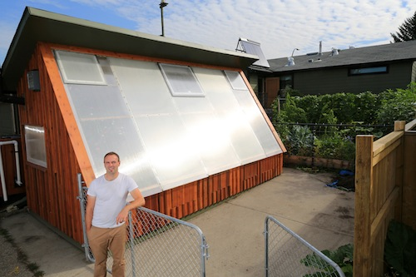
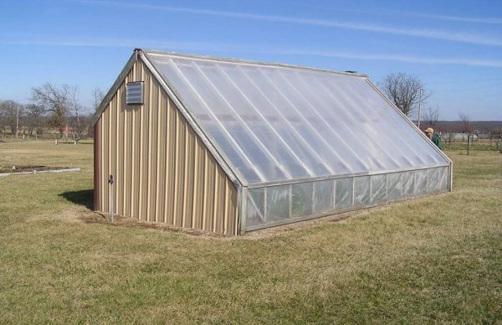
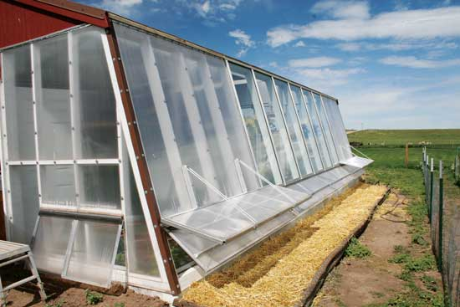
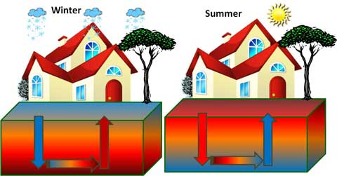
RESEARCH
Building structure
  Size
  Materials
  Design
Roof
  Material
  Shape
Heat system
  Store heat
  Circulate
  Exhaust
  Cooling
Insulation
  Type
  Rating

Slide 5
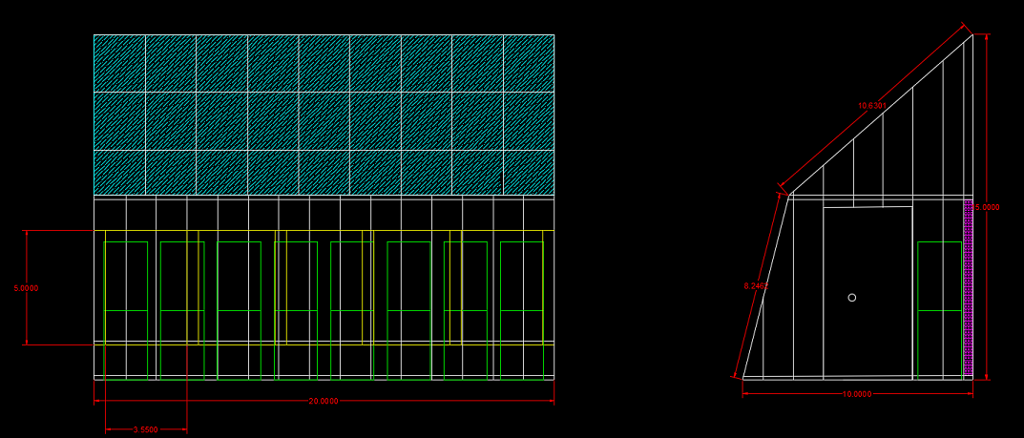
BUILDING STRUCTURE
Size
Materials
  Wood frame
  Concrete slab floor
Design
Location

Slide 6
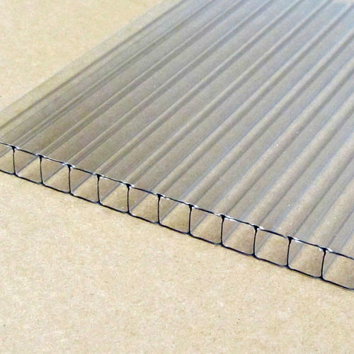
ROOF
Material
  Polycarbonate sheeting
    Natural ultraviolet filter, protection for plants against excessive radiation

Slide 7
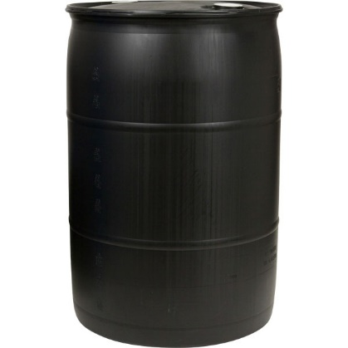
HEAT SYSTEM
Storage
  Black 55 gal drums (water)
    Stacked 2 high, the length of the greenhouse

Slide 8
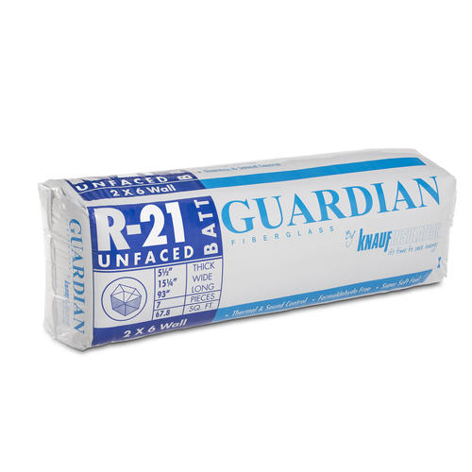
INSULATION
Basic residential insulation with an R value of 21. This will keep the heat that is captured from escaping to the outside.

Slide 9
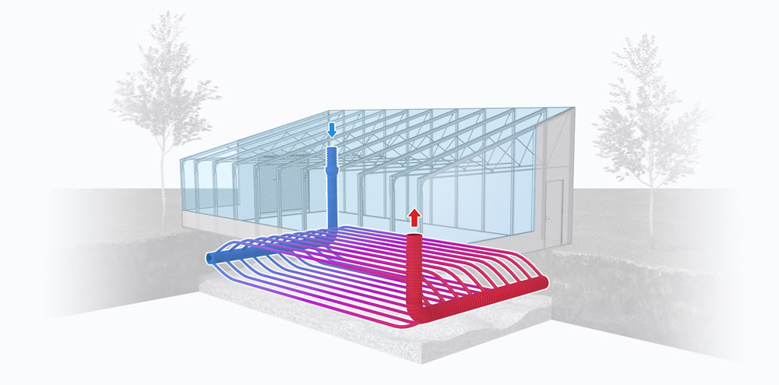
GAHT SYSTEM
“The GAHT™ system has been keeping the greenhouse to a minimum of 40°F while the outdoor temps have been anywhere from -10 to – 25°F. The “thermal bubble” beneath the greenhouse has been our biggest energy source, and that has been fueling us adequately.”
Source: https://www.ceresgs.com/climate-control/gaht/

Slide 10
GAHT SYSTEM
Heating and cooling
  The fan draws hot air during the day from the greenhouse through piping layout underground, which cools the greenhouse; also this will heat the ground
  During the colder periods, the stored heat in the ground is then pumped back into the greenhouse
Humidity control
  During the cooling process, water vapor is produced causing a higher humidity per evaporation when the greenhouse is heating up
  Circulating air underground, the air cools reaches the dew point and the water is condensed
  Results in cooler, drier air that is pumped back into the greenhouse
Air Circulation
  When the outside temperature is too warm or too cool for standard ventilation, this system provides air circulation
  Photosynthesis is accelerated in this process
  The risk of mold, pathogens, pests, and diseases are reduced

Slide 11
PARTS AND MATERIALS
Quantity | Part # | Description | Price (Unit) | Web Link where part was found | Total Price (Quantity x Price)
16 | 1021761 | Lumber 2x6x10 | $ 7.00 | Menards.com | $ 112.00
10 | 1111037 | Lumber 2x6x10 Treated | $ 8.00 | Menards.com | $ 80.00
60 | 1021114 | Lumber 2x4x10 | $ 4.00 | Menards.com | $ 240.00
40 | 1021101 | Lumber 2x4x8 | $ 3.00 | Menards.com | $ 120.00
10 | 1021127 | Lumber 2x4x12 | $ 5.00 | Menards.com | $ 50.00
7 | 1235285 | 3/4" Plywood 4'x8' Treated | $ 49.00 | Menards.com | $ 343.00
20 | 1242809 | 1/2" OSB 4'x8' | $ 18.00 | Menards.com | $ 360.00
5 | 100137 | Framing Screws (210 ct) 3 1/8" | $ 30.00 | Menards.com | $ 150.00
2 | 4140315 | Pre-hung 36"x80" Steel/insulated door | $ 200.00 |  | $ 400.00
13 | 510517 | Insulation | $ 38.00 | Menards.com | $ 494.00
3 | B0036E58H2 | Gigavent | $ 130.00 | Amazon.com | $ 390.00
1 | RTH221B1021/A | Thermostat | $ 20.00 | Amazon.com | $ 20.00
16 | B006KAAUSQ | Black 55 gal Plastic Drums | $ 62.00 | Amazon.com | $ 992.00
3 |  | Concrete (yds) | $ 110.00 | jonesandsons.com | $ 330.00
1 |  | GAHT system (piping) | $ 595.00 | ceresgs.com | $ 595.00
2 | GP301C | GAHT system fan (radon fan) | $ 192.00 | Menards.com | $ 384.00
10 | 10mmcleartwinwall4x14 | Polycarbonate sheet | $ 134.00 | Menards.com | $ 1,340.00
2 | 1476160 | Solar power vent fan | $ 215.00 | Menards.com | $ 430.00
12 | 1557691-42 | Metal Siding | $ 31.00 | Menards.com | $ 372.00

Slide 12
REFERENCES
Avis, R. (2016, November 6). 7 TIPS FOR PASSIVE SOLAR GREENHOUSE DESIGN. Retrieved November 11, 2017, from https://vergepermaculture.ca/2014/11/06/passive-solar-greenhouse-design/
Briggs, A. (2005). Passive Solar Greenhouse. Retrieved November 11, 2017, from http://bradford.cafnr.org/passive-solar-greenhouse/
Giebler, B. (2016, January). DIY Principles for a Passive Solar Greenhouse. Retrieved November 11, 2017, from https://www.grit.com/farm-and-garden/greenhouses/passive-solar-greenhouse-zm0z16jfzreg
Ground to Air Heat Transfer (GAHT™) Systems. (2016, January). Retrieved November 11, 2017, from https://www.ceresgs.com/climate-control/gaht/#1470863111395-7e0ee65e-7e79
Storey, N. (2013, September 24). Low Grade Geothermal Heating and Cooling for Greenhouses. Retrieved November 11, 2017, from https://blog.brightagrotech.com/low-grade-geothermal-heating-cooling-greenhouses/

